Slide 1
Lesson 1
Fast AI Part 1 v2

Slide 2
Outline
Lesson resources
Key concepts
ML process
Set up
Run model
Jeremy’s treats and tricks

Slide 3
Lesson resources
Lesson 1 video (unedited)
https://www.youtube.com/watch?v=ZDq5OXsLO3U
Lesson 1 notes (thanks Tim & Sarada):
http://forums.fast.ai/t/deeplearning-lec1notes/7089
Forum for deep learning beginners
http://forums.fast.ai/c/part1v2-beg
Annotated notebook
http://forums.fast.ai/uploads/default/original/2X/b/b01dffa62debfb8450fb9a3969d650645c54a3aa.pdf

Slide 4

Concepts
Convolutions
http://setosa.io/ev/image-kernels/
Play with the interactive website (you can even upload your own photo or video)
Stochastic Gradient Decent and the Learning Rate
Fine-tuning and differential learning rates
Test time augmentation (TTA)
Over-fitting
Data augmentation
Backpropagation: https://youtu.be/Ilg3gGewQ5U
Learning rate annealing

Slide 5
Learning rate
Learning
Learning rate = gradient x step
Learning rate is too high if the losses are increasing, not decreasing
Plot loss against learning rate
Use scientific notation when setting the learning rate in Python: 1e-1
Inspect learn.sched.plot()to determine the appropriate learning rate
Learning
Learning rate annealing
Learning rate versus number of iterations plot. Should be inverse relationship
Cosine annealing to cycle the learning rate over iterations
Learn.sched.plot_lr()

Slide 6

Fine-tuning and differential learning rates
Learn.unfreeze() unfreezes all the layers to train them
Later layers (containing more complex features) need more training than earlier layers (containing primitive features like edges)
Can specify a learning rate array for different groups of layers;
lr=np.array([1e-4,1e-3,1e-2])
learn.fit(lr, 3, cycle_len=1, cycle_mult=2);
3 indicates the number of cycles
cycle_mult=2 doubles the length of the cosine annealing cycle

Slide 7
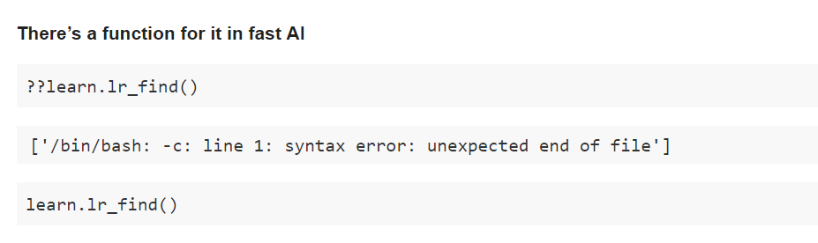
Learning rate

Slide 8
Test time augmentation (TTA)
After the model is trained, take four random data augmentations and calculate the average of the predictions
01
Learn.TTA() increases the accuracy
Zoom in might be better than padding to get square shapes
02

Slide 9
Data augmentation
Helps reduce over-fitting by creating more variation across the training set
Use this argument: transform_side_on
tfms_from_model(resnet34, sz, aug_tfms=transforms_side_on, max_zoom=1.1)

Slide 10
ML Process
Load and normalizing
Load and normalizing training and test datasets using
Define
Define a loss function
Train
Train the network on the training data
Test
Test the network on the test data

Slide 11
Set up
Three choices for cloud computing
Crestle (crestle.com), Amazon Web Services, Paperspace.com
Amazon machine image (AMI):
http://forums.fast.ai/t/aws-ami-available-for-testing/7255
Set up AWS CLI
http://docs.aws.amazon.com/cli/latest/userguide/tutorial-ec2-ubuntu.html
Fast AI Github repository
https://github.com/fastai/fastai
Required folder structure
Train
Test
Valid
fastai-part1v2-p2, id is ami-8c4288f4, region is Oregon.
NB: this only works with P2 instances

Slide 12
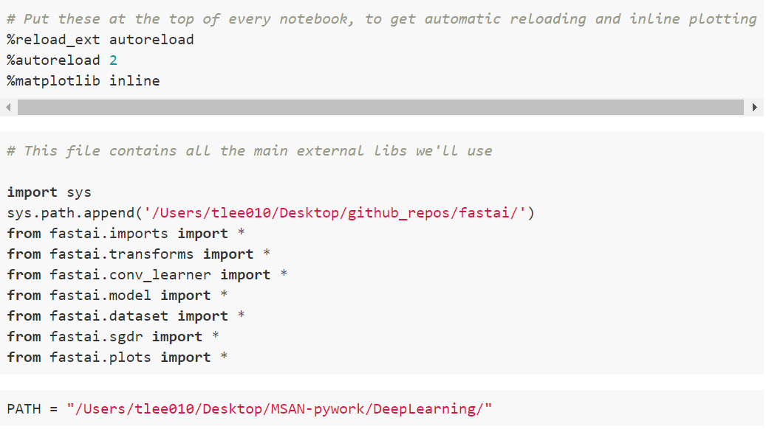
Set up

Slide 13
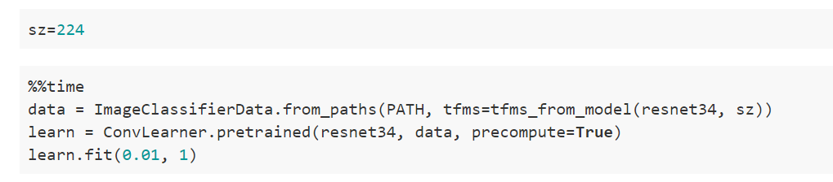
Run the model

Slide 14
Jeremy’s treats and tricks
Fast AI library for Python
Use Resnet 34, its generally the better library
AWS educate: there are credits available
Machine learning course:
Lesson 1196
Lesson 280
Lesson 345
Lesson 414

